Slide 1

Test Driven Cookbook Development
Notes:
Welcome to Writing Great Unit Tests with ChefSpec.

Slide 2

Franklin Webber
Training and Technical Content Lead
US Army - Radio/COMSEC Repairer (35E)
Tech Support
Quality Assurance
Software Developer Eng. in Test
Software Developer
Instructor / Trainer
Notes:
Before we start let me introduce myself.

Slide 3
You
Chef Cookbook Author
Smart, intelligent, and funny
Understand Chef Resources and Cookbooks
Used Test Test Kitchen and know something about Chef Testing Tools

Slide 4
Schedule
NOW – Housekeeping
@ 3 min – Slides & Live Demonstration
@ 45 min – Questions
@ 55 min – Resources and Wrap-up

Slide 5
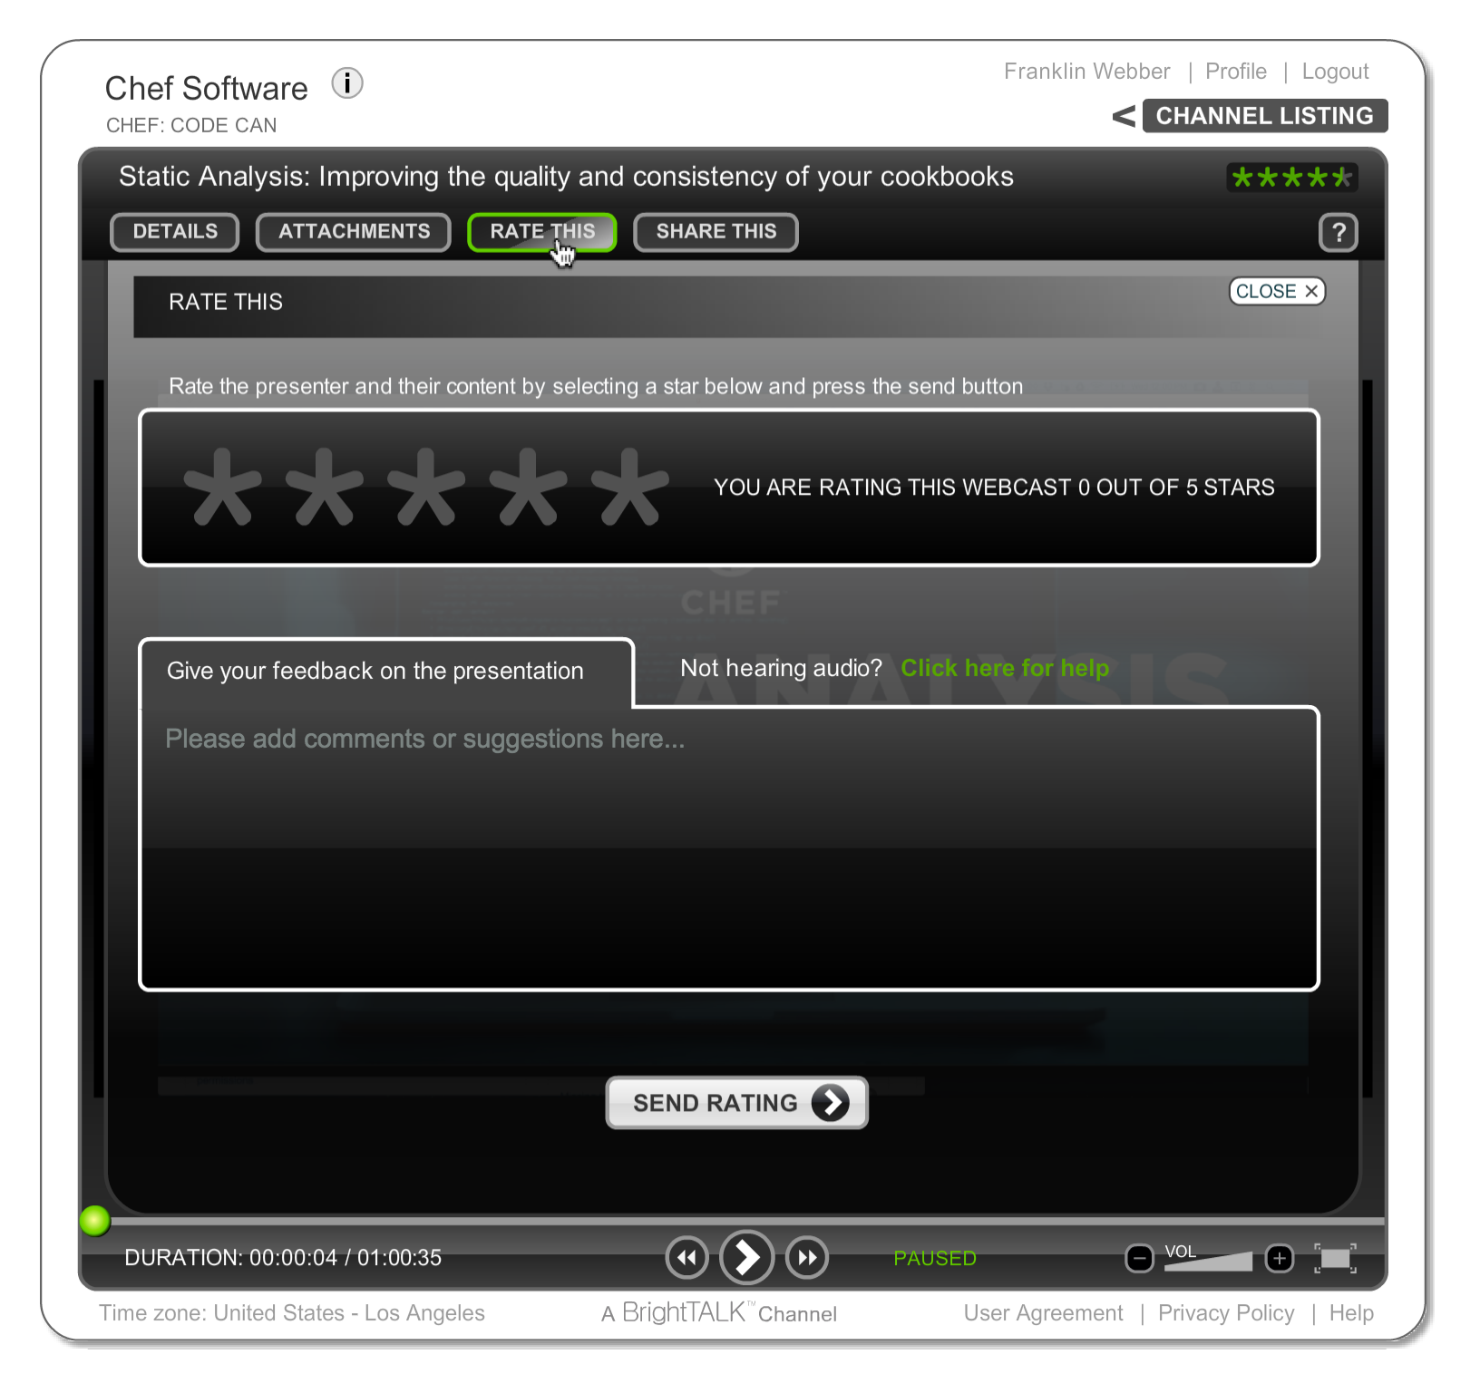
Let Us Know What You Think
"Ask a Question" and I will answer it.
"Rate This" presentation to leave your feedback and help me do my work better.

Slide 6

Was this Valuable to You?
Share it with your professional and social networks.

Slide 7
Test Driven Cookbook Development
Notes:
Welcome to Writing Great Unit Tests with ChefSpec.

Slide 8

Agenda
Review Existing Cookbook
Faster Feedback with Unit Tests
Testing Resources
Refactoring to Attributes
Debugging
Further Resources
Hello, world!

Slide 9
Examine the Content of the httpd cookbook
> tree httpd
httpd
├── Berksfile
├── Berksfile.lock
├── README.md
├── chefignore
├── metadata.rb
├── recipes
│ ├── default.rb
│ └── install.rb
10 directories, 12 files

Slide 10
Gain Important Insights from the README
~/httpd/README.md
# httpd
TODO: Enter the cookbook description here.

Slide 11
Find the Culprit
> cd httpd
> git log
commit 4ad7914230b67bcaf534b2f121a08359eae18fde
Author: Franklin Webber <franklin.webber@gmail.com>
Date: Tue Mar 22 10:57:45 2016 -0500
Initial Commit
Sorry future me I didn't write a README. But at least I wrote a git commit message.

Slide 12
View the Test Kitchen Configuration File
~/.kitchen.yml
# ... TOP OF THE FILE ...
platforms:
- name: centos-6.7
suites:
- name: default
run_list:
- recipe[httpd::default]
attributes:

Slide 13
Find Purpose from the Integration Tests
~/httpd/test/integration/default/serverspec/default_spec.rb
require 'spec_helper'
describe 'httpd::default' do
describe command('curl http://localhost') do
its(:stdout) { should match(/Welcome Home/) }
end
end

Slide 14
View the Contents of the Default Recipe
~/httpd/recipes/default.rb
#
# Cookbook Name:: httpd
# Recipe:: default
#
# Copyright (c) 2016 The Authors, All Rights Reserved.
include_recipe 'httpd::install'
file '/var/www/html/index.html' do
content '<h1>Welcome Home!</h1>'
end
service 'httpd' do
action [:enable, :start]
end

Slide 15
View the Contents of the Install Recipe
~/httpd/recipes/install.rb
#
# Cookbook Name:: httpd
# Recipe:: install
#
# Copyright (c) 2016 The Authors, All Rights Reserved.
package 'httpd'

Slide 16
Agenda
Review Existing Cookbook
Faster Feedback with Unit Tests
Testing Resources
Refactoring to Attributes
Debugging
Further Resources
Time to get to work!

Slide 17
Slower Feedback Cycle
The slower the feedback loop the less value it provides to you while developing your cookbooks. You are less inclined to run the test suite. Which means you will likely miss issues as they happen.

Slide 18
External Dependencies
Create CentOS Instance
Install Chef
Apply the Run List
The speed of the test suite is affected by the external dependency on the creation of the test instance, installing chef, and applying the run list.
Build Node (ohai)
Synchronize Cookbooks
Build Resource Collection
Converge
Execute Tests
Notes:
The reason that the feedback cycle takes as long as it does with Test Kitchen is because of the external requirements. Creating the test instance, installing chef, and then applying the run list provide real value because we are able to see the recipe being applied to a virtual instance. However, all these external dependencies incur a time cost as we wait for the network to download images or packages, the test instance's processor to calculate keys or data, or the file-system to create files and folders.

Slide 19
Create CentOS Instance
Install Chef
Build Resource Collection
Apply the Run List
The resource collection is a list of all the resources and recipes loaded across all the recipes within the run list.
Build Node (ohai)
Synchronize Cookbooks
Build Resource Collection
Converge
Execute Tests
Notes:
When we mutated our code and executed the test suite we created issues with the resources that we defined and recipes that we included. These changes affected the resources that were applied to the system by omitting resources from the 'Resource Collection'. If we were able to remove the external dependencies and focus on the state of the Resource Collection we would be able to determine if there were problems with the recipes we wrote without the need of any of those external dependencies.

Slide 20
Resource Collection
httpd
default
Resource Collection
install
package 'httpd'
configuration
file '/var/w...
service
service 'httpd'
Notes:
But first let's talk more about the 'Resource Collection' ...
After a cookbook and its recipes have been synchronized the majority of the cookbook content is loaded into memory by 'chef-client'. The recipes defined on the run list are evaluated during this time and the resources found within the recipes and any included recipes, are added to a resource collection. They are not immediately executed like one might assume.
The 'Resource Collection' is almost like a to-do list for the node. It contains the list of all the resources, in order, that need to be accomplished to bring the instance into the desired state. Later, in the converge step, the resources defined in the Resource Collection are executed and perform their various forms of test-and-repair to bring the instance into the desired state.

Slide 21
RSpec and ChefSpec
RSpec is a Domain Specific Language (DSL) that allows you to express and execute expectations. These expectations are expressed in examples that are asserted in different example groups.
ChefSpec provides helpers and tools that allow you to express expectations about the state of resource collection.
ChefSpec
RSpec
Chef
Ruby
Notes:
ChefSpec provides a method for us to create an in-memory execution of applying the run list, building the resource collection, and then setting up expectations about the state of the resource collection. ChefSpec, similar to ServerSpec is built on top of RSpec; relying on it to provide the core framework and language. The benefit to us is that a lot of the same language constructs are employed.

Slide 22
Test Kitchen versus ChefSpec
ChefSpec
Build Node (Fauxhai)
Build Resource Collection
Execute Tests
Test Kitchen using ServerSpec
Create CentOS Instance
Install Chef
Apply the Run List
Execute Tests
Notes:
Verifying the resource collection with ChefSpec requires far fewer external dependencies and that allows us to get feedback faster but at the cost of not applying the recipes we write against a test instance. This opens us up to situations were we could compose recipes and execute examples that are shown to work because they were correctly added to the resource collection but fail when it comes time for the recipes to apply the desired state against a test instance.

Slide 23

Faster Feedback While Developing Cookbooks
The faster the feedback from our tests, the more likely we are to run them. The more likely we are to run them means they will catch more issues.
Review and run the existing tests
Identify the tests that we need to write
Write and execute the tests to identify the failure
Fix the code and execute the tests to see success
A tidy life is a healthy life.
Notes:
We have the integration test, the one defined in ServerSpec, executed through Test Kitchen to ensure the recipes we write behave as we expect on the test instances we define. The benefit of writing tests focused around the Resource Collection will allow us to gain feedback quickly and build a better development workflow.
This next group exercise we will review the existing ChefSpec specifications defined for us and how we can expand them to capture our additional expectations about the Resource Collection.

Slide 24
View the Spec Directory
> tree spec
spec
├── spec_helper.rb
└── unit
└── recipes
├── configuration_spec.rb
├── default_spec.rb
├── install_spec.rb
└── service_spec.rb
2 directories, 6 files
Notes:
When generating recipe files we were also given a matching specification file in the 'spec/unit' directory. The ChefSpec defined specifications are all contained within this directory.

Slide 25
View the Test for the Default Recipe
~/httpd/spec/unit/recipes/default_spec.rb
require 'spec_helper'
describe 'httpd::default' do
context 'When all attributes are default, on an unspecified platform' do
let(:chef_run) do
runner = ChefSpec::ServerRunner.new
runner.converge(described_recipe)
end
it 'converges successfully' do
expect { chef_run }.to_not raise_error
end
end
end
Notes:
Open up the default specification file and lets read through and begin to understand the initial expectation that is automatically defined.
The expectations defined in this initially generated specification file should look a little familiar. This is because ChefSpec is built on Rspec. Similar to how ServerSpec is built. ChefSpec requires a little more setup as we are creating an in-memory execution.

Slide 26
View the Test for the Default Recipe
~/httpd/spec/unit/recipes/default_spec.rb
example groups
require 'spec_helper'
describe 'httpd::default' do
context 'When all attributes are default, on an unspecified platform' do
let(:chef_run) do
runner = ChefSpec::ServerRunner.new
runner.converge(described_recipe)
end
it 'converges successfully' do
expect { chef_run }.to_not raise_error
end
end
end
cookbook name::recipe name
Notes:
It is often common for specification files to share similar functionality. As your suite of examples grows you will often move common, shared expectations and helpers to a common file that is required here at the top of the file. This will load the contents of the 'spec_helper' file found within the root of the 'spec' directory.
ChefSpec employs RSpec's example groups to describe the cookbook's recipe. This is stating that the examples we defined within this outer example group all relate to the httpd cookbook's default recipe. Within this example group we see another context that is defined. This time using the method 'context'. 'context' and 'describe' are exactly same in almost every way. A lot of developers like to use context as it more clearly states that the example group is focused on a particular scenario. In this instance the particular scenario we are going to be specifying examples in a scenario where all the attributes are default on an unspecified platform.
Instructor Note: 'describe' and 'context' are almost completely interchangeable with one exception. 'context' cannot be used as the outermost example group.

Slide 27
View the Test for the Default Recipe
~/httpd/spec/unit/recipes/default_spec.rb
require 'spec_helper'
describe 'httpd::default' do
context 'When all attributes are default, on an unspecified platform' do
let(:chef_run) do
runner = ChefSpec::ServerRunner.new
runner.converge(described_recipe)
end
it 'converges successfully' do
expect { chef_run }.to_not raise_error
end
end
end
example
expectation
Notes:
Within the inner context we finally set the stage for us to define our examples with their expectations. There is a single example defined and that is stating that when the chef run evaluates and creates the resource collection it should do so without raising an error. A situation that might raise an error is if we included a recipe that does not exist or if we were to use a resources type that does not exist.

Slide 28
View the Test for the Default Recipe
~/httpd/spec/unit/recipes/default_spec.rb
described recipe
require 'spec_helper'
describe 'httpd::default' do
context 'When all attributes are default, on an unspecified platform' do
let(:chef_run) do
runner = ChefSpec::ServerRunner.new
runner.converge(described_recipe)
end
it 'converges successfully' do
expect { chef_run }.to_not raise_error
end
end
end
Ruby Class
chef_run helper
Notes:
The 'chef_run' helper there is being provided by the 'let' defined above the example within the same context. Defining the 'chef_run' in the 'let' above is done with a Ruby Symbol. This is simply naming it so that it can be used within any of the examples in the current context and even sub-contexts. The helper is simply executing some code that sets up an in-memory chef-client run with a Chef Server.
The 'ServerRunner' is a class defined within the 'ChefSpec' namespace. All Ruby classes have the method 'new' which will return an object which is a new instance of that described class. The object is stored in a local variable, named 'runner', which immediately invokes a method 'converge' with a single parameter 'described_recipe'
The parameter 'described_recipe' refers to the recipe defined in the outermost describe. This is mostly for convenience so that we do not have to redefine the same String multiple times within the same specification file.
The goal of this single, boilerplate example is very simple: perform a chef-client run and ensure there are no errors. Now, let's execute this specification.

Slide 29
Execute the Test for the Default Recipe
> chef exec rspec spec/unit/recipes/default_spec.rb
.
Finished in 0.44592 seconds (files took 4.35 seconds to load)
1 example, 0 failures
passing example
Notes:
To execute the specification file defined you will need to run the command 'rspec'. The 'rspec' command was installed with the Chef Development Kit (ChefDK) on the workstation. It is contained in an additional folder of tools embedded within the ChefDK that are not added to the system path. This is because some Chef developers are Ruby developers and may already have a version of RSpec installed. Specifying the 'chef exec' as a prefix loads the context of all these embedded tools and allows them to be executed on the command-line.
The 'rspec' command accepts many parameters. The most important one is used here and that is specifying the file path to the specification we want to execute. When the command executes a summary of the executed examples will be displayed at the bottom. At this moment it looks like the one expectation completes successfully. The chef run completes without any errors.
Instructor Note: On the workstations the learners do not need to prepend the rspec command with 'chef exec'. This is because 'rspec' and all the other tools embedded in the ChefDK have been added to the path. On a learner's local system this is likely not the case and so they will need to type this entire command with prefix.

Slide 30
Faster Feedback While Developing Cookbooks
The faster the feedback from our tests, the more likely we are to run them. The more likely we are to run them means they will catch more issues.
Review and run the existing tests
Identify the tests that we need to write
Write and execute the tests to identify the failure
Fix the code and execute the tests to see success
What must we do?
Notes:
We have the language and the tool that will allow us to express our expectations. We now need to examine the recipe again to see what example or examples we want to define within the specification file.

Slide 31
We Should Test the Inclusion of a Recipe
~/httpd/recipes/default.rb
#
# Cookbook Name:: httpd
# Recipe:: default
#
# Copyright (c) 2016 The Authors, All Rights Reserved.
# include_recipe 'httpd::install'
include_recipe 'httpd::configuration'
include_recipe 'httpd::service'
Notes:
Within the default recipe we commented out the line that included the install recipe from the httpd cookbook. This seems like an expectation that we want to define. When converging the default recipe we expect that the install recipe from the httpd cookbook would be included.
We do not yet know how to define this expectation but we know the work that we want to accomplish. So lets take this one step at a time then and first capture the description for the example even if we do not yet know how to express the expectation.

Slide 32
Create a Pending Test
~/httpd/spec/unit/recipes/default_spec.rb
# ... START OF THE SPEC FILE ...
it 'converges successfully' do
expect { chef_run }.to_not raise_error
end
it 'includes the install recipe'
end
end
Notes:
Returning to the specification we can describe the example that we want to create without having to know how to define the expectation by defining an example without the block. RSpec treats these examples without the associated block as a pending test.
This is an incredibly useful feature when you want to start expressing your examples. This allows you to quickly identify all the examples without getting mired in the details of their implementation.

Slide 33
Execute the Tests to See the Pending Tests
> chef exec rspec spec/unit/recipes/default_spec.rb
.*
Pending: (Failures listed here are expected and do not affect your suite's status)
1) httpd::default When all attributes are default, on an unspecified platform includes the install recipe
# Not yet implemented
# ./spec/unit/recipes/default_spec.rb:20
# ... OUTPUT CONTINUES ON NEXT SLIDE ...
pending example
Notes:
When executing 'rspec' again we should see the new pending example that we defined within the specification file.

Slide 34
Execute the Tests to See the Pending Tests
> chef exec rspec spec/unit/recipes/default_spec.rb
.*
Pending: (Failures listed here are expected and do not affect your suite's status)
1) httpd::default When all attributes are default, on an unspecified platform includes the install recipe
# Not yet implemented
# ./spec/unit/recipes/default_spec.rb:20
# ... OUTPUT CONTINUES ON NEXT SLIDE ...
summary
spec file : line number
Notes:
RSpec's pending summary is similar to the failure summary. The pending examples are identified and then finally they are collected together in list. Each pending example will show the words you used in the description text in a single sentence. Below that it will state the example is not yet implemented and then finally display the file path and line number of where it can be found.

Slide 35
View the Results to See the Pending Tests
> chef exec rspec spec/unit/recipes/default_spec.rb
# ... OUTPUT CONTINUED FROM PREVIOUS SLIDE ...
Finished in 0.46457 seconds (files took 4.39 seconds to load)
2 examples, 0 failures, 1 pending
Notes:
The summary will now display that an additional example has been added and it will be reported as being set to pending.

Slide 36
Faster Feedback While Developing Cookbooks
The faster the feedback from our tests, the more likely we are to run them. The more likely we are to run them means they will catch more issues.
Review and run the existing tests
Identify the tests that we need to write
Write and execute the tests to identify the failure
Fix the code and execute the tests to see success
I seek failure and I seek it fast!
Notes:
Now that we have defined the pending example, setting up the work for ourselves, it is time to learn how to express the expectation.

Slide 37
ChefSpec Documentation
Find within the documentation examples of testing for include_recipe.
Search the README
Search through the 'examples' directory
https://github.com/sethvargo/chefspec
Notes:
To understand how to express an expectation we need to go to the documentation. The ChefSpec README provides a wealth of examples in the README. In the past an 'include_recipe' example has been one of the many examples shared in the README. Use the search feature of your browser to find it within the document.
If it is not there, the ChefSpec project has a top-level folder named 'examples' which contains examples for nearly every feature that ChefSpec is able to define expectations. Searching through there you will find a folder titled 'include_recipe', within it should a folder the shows the recipes and the matching specifications.

Slide 38
Write the Test that Verifies the Include Recipe
~/httpd/spec/unit/recipes/default_spec.rb
# ... START OF THE SPEC FILE ...
it 'converges successfully' do
expect { chef_run }.to_not raise_error
end
it 'includes the install recipe' do
expect(chef_run).to include_recipe('httpd::install')
end
end
end
Notes:
Returning to the specification file we now need to expand the example to include the expectation we want to write. To do that we add a 'do' to the end of the example. We move to the next line, indent two spaces and then define the following expectation. The expectation uses a natural language way of expressing the expectation. Here we are expressing the expectation that the 'chef_run' includes the recipe with the specified name.

Slide 39
Execute the Tests to See the Failure
> chef exec rspec spec/unit/recipes/default_spec.rb
.F
Failures:
1) httpd::default When all attributes are default, on an unspecified platform includes the install recipe
Failure/Error: expect(chef_run).to include_recipe('httpd::install')
expected ["httpd::default"] to include "httpd::install"
# ./spec/unit/recipes/default_spec.rb:21:in `block (3 levels) in <top (required)>'
failing example
Notes:
With the example defined with the expectation when we execute 'rspec' we see the failure that eluded us we ran 'kitchen converge & verify' on an existing very quickly.
The failure summary here is similar to the failure summary return by RSpec when employed by Test Kitchen. The example is displayed, the expectation is expressed, the failure to meet expectation and file name and line number within the file where to find the expectation.

Slide 40
Faster Feedback While Developing Cookbooks
The faster the feedback from our tests, the more likely we are to run them. The more likely we are to run them means they will catch more issues.
Review and run the existing tests
Identify the tests that we need to write
Write and execute the tests to identify the failure
Fix the code and execute the tests to see success
I am the mender of my infrastructure.
Notes:
Now that we have a failing test it is time to fix the problem.

Slide 41
Uncomment the Include Recipe
~/httpd/recipes/default.rb
#
# Cookbook Name:: httpd
# Recipe:: default
#
# Copyright (c) 2016 The Authors, All Rights Reserved.
include_recipe 'httpd::install'
include_recipe 'httpd::configuration'
include_recipe 'httpd::service'
Notes:
Returning to the default recipe it is time to restore the code that we previously commented out.

Slide 42
Execute the Tests to See it Pass
> chef exec rspec spec/unit/recipes/default_spec.rb
..
Finished in 0.67714 seconds (files took 4.26 seconds to load)
2 examples, 0 failures
Notes:
Executing 'rspec' one more time should show the previous failing example now as a passing example.

Slide 43
Faster Feedback While Developing Cookbooks
The faster the feedback from our tests, the more likely we are to run them. The more likely we are to run them means they will catch more issues.
Review and run the existing tests
Identify the tests that we need to write
Write and execute the tests to identify the failure
Fix the code and execute the tests to see success
The hair grows; the blades dull.
Notes:
Now we can confidently state that the default recipe includes the install recipe and we can receive this verification in a faster feedback cycle then we saw with running 'kitchen test'.
Mutation testing is not Test Driven Development (TDD) but the act that we performed was fairly close. This is a tactic that is useful when you are writing expectations for already defined recipes for existing cookbooks or when it feels near impossible to start with the tests first. This process does one of the important aspects of TDD which is ensure the expectations we set correctly capture the state of the code.

Slide 44
Agenda
Review Existing Cookbook
Faster Feedback with Unit Tests
Testing Resources
Refactoring to Attributes
Debugging
Further Resources

Slide 45
Testing Remaining Resources
No resources left behind!
Write and execute tests for the Install recipe
Verify the test validates the recipe
Notes:
If we continued to use the mutation testing approach we would find similar problems with in the other recipes that we developed. Together let's work through defining examples for this recipe and then you will have a lab later to complete the remaining recipes.

Slide 46
Generated Recipes Also Generate Specs
> tree spec
spec
├── spec_helper.rb
└── unit
└── recipes
├── configuration_spec.rb
├── default_spec.rb
├── install_spec.rb
└── service_spec.rb
Notes:
Back when we generated the recipe with the 'chef' command-line utility a matching specification file was also generated. Similar to the default recipe specification the install recipe specification contains a single example that ensures that the chef run completes without error.

Slide 47
Execute the Install Specification
> chef exec rspec spec/unit/recipes/install_spec.rb
.
Finished in 0.46874 seconds (files took 4.24 seconds to load)
1 example, 0 failures
Notes:
Using 'rspec' we can verify that the one example completes successfully.

Slide 48
Add a Pending Test to Verify the Package
~/httpd/spec/unit/recipes/install_spec.rb
# ... START OF THE SPEC FILE ...
it 'converges successfully' do
expect { chef_run }.to_not raise_error
end
it 'installs the necessary package'
end
end
Notes:
The install recipe installs the necessary the necessary software for the webserver. We can start by writing a pending example.

Slide 49
ChefSpec Documentation
Find within the documentation examples of testing packages
https://github.com/sethvargo/chefspec/tree/master/examples/package
Notes:
Now it is time returned to the documentation. Again, the ChefSpec documentation contains a lot of examples in the README and the examples directory. Using either of those find an example of an expectation expressing that a packaged is installed.

Slide 50
Write the Test to Verify the Package
~/httpd/spec/unit/recipes/install_spec.rb
# ... START OF THE SPEC FILE ...
it 'converges successfully' do
expect { chef_run }.to_not raise_error
end
it 'installs the necessary package' do
expect(chef_run).to install_package('httpd')
end
end
end
Notes:
With a good example we found in the documentation we can return to the example and define the example. In our case we want to assert that the the chef run installs the package 'httpd'.

Slide 51
Write the Test to Verify the Package
~/httpd/spec/unit/recipes/install_spec.rb
# ... START OF THE SPEC FILE ...
it 'converges successfully' do
expect { chef_run }.to_not raise_error
end
it 'installs the necessary package' do
expect(chef_run).to install_package('httpd')
end
end
end
resource's name
resource's action
resource
Notes:
Expressing an expectation for the state of resources in the 'Resource Collection' uses a particular matcher. Express the name of the action joined together with the type of the resource and has the parameter that is the name of the resource.
The expectation defined here is slightly different than the previous example. In the first example the expect uses braces. This is Ruby's shorthand notation to represent a block. The reason in this expectation we want to use a block is that if the chef run were to raise an error we need to catch it. Catching it requires that we wrap the code we want to execute within a block.
Using the parenthesis is passing the 'chef_run' helper as a parameter to the 'expect' method. In this instance we do not expect an error to take place and instead want to make assertions on the state of the chef run. If an error were to be raised the expectation would not catch it and instead of the expectation failing you would see an error message.

Slide 52
Execute the Test to See it Pass
> chef exec rspec spec/unit/recipes/install_spec.rb
..
Finished in 0.73662 seconds (files took 4.4 seconds to load)
2 examples, 0 failures
Notes:
When we are done writing this expectation and execute the test suite we see that we now have 2 examples that both pass.

Slide 53
Testing Remaining Resources
No resources left behind!
Write and execute tests for the Install recipe
Verify the test validates the recipe
Notes:
We now have an expectation that expresses the state for the install recipe. But before we declare victory it is time to verify that the expectations truly are working.

Slide 54
It's Quiet. Too Quiet.
When a test passes immediately without having to write code (or if the code has already been written) it is time to be concerned. This is one of those moments we should ensure that the tests are working by mutating that code.
Notes:
If a test passes and you have never seen it fail. How do you know it works? Without ever seeing a failure there is situation where we could be seeing a 'false positive'. This is because we did not develop this expectation with the test first. In this instance we have not done anything wrong. We simply need to ensure that the expectation we define will fail if we were to modify the code that we are testing.
To do that it is time for us to return to the recipe and modify it, mutate it, to ensure that the test fails.

Slide 55
Comment Out the Resource
~/httpd/recipes/install.rb
#
# Cookbook Name:: httpd
# Recipe:: install
#
# Copyright (c) 2016 The Authors, All Rights Reserved.
# package 'httpd'
Notes:
One simple mutation is to remove the resource by commenting it out or removing it. We could also choose to rename the name of the resource.

Slide 56
Execute the Test to See it Fail
> chef exec rspec spec/unit/recipes/install_spec.rb
.F
Failures:
1) httpd::install When all attributes are default, on an unspecified platform installs the appropriate package
Failure/Error: expect(chef_run).to install_package('httpd')
expected "package[httpd]" with action :install to be in Chef run. Other package resources:
Notes:
Returning to run the tests we now see that there is an error in the execution. The change that we made to the recipe, the removal of the resource, generates this error. We can state with confidence that the expectation that we defined properly insures our expectations about the 'Resource Collection'.

Slide 57
Uncomment Out the Resource
~/httpd/recipes/install.rb
#
# Cookbook Name:: httpd
# Recipe:: install
#
# Copyright (c) 2016 The Authors, All Rights Reserved.
package 'httpd'
Notes:
Time to restore the mutation we introduced.

Slide 58
Execute the Test to See it Pass
> chef exec rspec spec/unit/recipes/install_spec.rb
..
Finished in 0.73662 seconds (files took 4.4 seconds to load)
2 examples, 0 failures
Notes:
Verify that all the examples complete successfully.

Slide 59
Testing Remaining Resources
No resources left behind!
Write and execute tests for the Install recipe
Verify the test validates the recipe
Miss me?
Notes:
We walked through ensuring this recipe has the necessary expectations defined.

Slide 60
Agenda
Review Existing Cookbook
Faster Feedback with Unit Tests
Testing Resources
Refactoring to Attributes
Debugging
Further Resources
Now I am ready to be shaved.

Slide 61
Modular Cookbook Recipes
httpd
wordpress
default
default
install
configuration
configuration
service
Notes:
When we initially set out to create a cookbook that was more modular we broke the concerns of the webserver into three different recipes. This would allow an opportunity for cookbook authors within our organization re-use components of the cookbook by including only the recipes that they want.
Sometimes you do not want to re-define an entire new recipe and simply want to provide a different name or version for the package; a single file path for the configuration file.

Slide 62
Modular Cookbook Recipes
httpd
~/httpd/recipes/configuration.rb
default
file '/var/www/html/index.html' do
content '<h1>Welcome Home</h1>'
end
install
configuration
service
Notes:
Within each recipe we defined the resources necessary to bring the webserver into the desired state. When we expressed these resources we did so with values that worked for this platform and version of the Operating System (OS).
The configuration recipe defined a file resource with a path to the location for the default HTML page. This path is hard-coded for this particular platform. If we had a situation where another cookbook or environment or role wanted to use this recipe but provide a custom value we could not do that unless we talk about making the file path a node attribute.

Slide 63
The Node Object
Apply the Run List
node object
{}
system attributes
Build Node (ohai)
automatic
Synchronize Cookbooks
cookbook defined attributes
Load Cookbooks
default
normal
override
Build Resource Collection
Converge
https://docs.chef.io/attributes.html - attribute-precedence
Notes:
Cookbooks can define node attributes which are added to the node object after the initial discovery is done by Ohai. Ohai attributes are considered automatic and cannot be overwritten. However, the attributes defined in a cookbook can come in variety of levels. This allows for cookbooks to define a base value which another cookbook can replace when needed.
That is the kind of flexibility that we want to implement in our cookbook.

Slide 64
Refactor to Use Attributes
Time to remove all the hard-coded values and make them attributes.
Refactor the Install recipe to use a Node attribute
Execute the tests and verify the tests fail
Create the attributes file and add the Node attribute
Execute the tests and verify the tests pass
Dream Driven Development
Notes:
Together we will walk through refactoring the install recipe continuing to use our tests to prove that we have not caused a regression in recipes.

Slide 65
Replace the Value with a Node Attribute
~/httpd/recipes/install.rb
#
# Cookbook Name:: httpd
# Recipe:: install
#
# Copyright (c) 2016 The Authors, All Rights Reserved.
package node['httpd']['package_name']
Notes:
Because we have expectations in place we can start with a change to the install recipe. Here we are replacing the package name with a node attribute that we have yet to define in the attributes file.

Slide 66
Refactor to Use Attributes
A change means a chance for us to run the tests!
Refactor the Install recipe to use a Node attribute
Execute the tests and verify the tests fail
Create the attributes file and add the Node attribute
Execute the tests and verify the tests pass
Failure makes us stronger!
Notes:
We made a change. Before we define the node attribute we should run the tests.

Slide 67
Execute the Tests to See it Fail
> chef exec rspec
FFFFFF...
Failures:
1) httpd::default When all attributes are default, on an unspecified platform converges successfully
Failure/Error: expect { chef_run }.to_not raise_error
expected no Exception, got #<NoMethodError: undefined method `[]' for nil:NilClass> with backtrace:
# /tmp/d20161026-15641-1adgkog/cookbooks/httpd/recipes/install.rb:6:in `from_file'
Notes:
When executing 'rspec' against all the examples that we have defined we see a large number of failures. The failure summary will show us that the chef run failed with an error. This error is informing us that we attempted to retrieve an attribute from the node object that does not exist. All of the failures should be the same.

Slide 68
Refactor to Use Attributes
We definitely broke it! Now, let's fix it.
Refactor the Install recipe to use a Node attribute
Execute the tests and verify the tests fail
Create the attributes file and add the Node attribute
Execute the tests and verify the tests pass
The reality is what you code.
Notes:
Now it is time to create the attributes file and define the necessary attribute.

Slide 69
Ask Chef How to Generate an Attributes File
> chef generate attribute --help
Usage: chef generate attribute [path/to/cookbook] NAME [options]
-C, --copyright COPYRIGHT Name of the copyright hol...
-m, --email EMAIL Email address of the auth...
-a, --generator-arg KEY=VALUE Use to set arbitrary ...
-I, --license LICENSE all_rights, apache2, mit,...
-g GENERATOR_COOKBOOK_PATH, Use GENERATOR_COOKBOOK_PA...
--generator-cookbook
Notes:
The 'chef' tool is able to generate attributes. All it requires is the name of the file when you are inside the cookbook. We are currently inside the cookbook directory so now we need to give it a name.

Slide 70
Use Chef to Generate a Default Attributes File
> chef generate attribute default
Compiling Cookbooks...
Recipe: code_generator::attribute
* directory[/home/chef/httpd/attributes] action create
- create new directory /home/chef/httpd/attributes
* template[/home/chef/httpd/attributes/default.rb] action create
- create new file /home/chef/httpd/attributes/default.rb
- update content in file /home/chef/httpd/attributes/default.rb from none to e3b0c4
(diff output suppressed by config)
Notes:
The standard name for the attributes file is 'default'. This command will generate an attributes file named 'default.rb' in the attributes directory.

Slide 71
View the Attributes File Generated
> tree attributes
attributes
└── default.rb
0 directories, 1 file
Notes:
We can verify that by looking in the attributes directory to see the file has been generated.

Slide 72
Add the Default Node Attribute
~/httpd/attributes/default.rb
default['httpd']['package_name'] = 'httpd'
Notes:
Now it is time to edit the attributes file and define the node attribute. Here we are defining the node attribute at the default level. Setting it to default will allow other cookbooks to override it if necessary.

Slide 73
Refactor to Use Attributes
The work is done. Let's hope it's the right work. Run the tests!
Refactor the Install recipe to use a Node attribute
Execute the tests and verify the tests fail
Create the attributes file and add the Node attribute
Execute the tests and verify the tests pass
Notes:
This change should fix all the examples that we broke when we used the node attribute without having defined it.

Slide 74
Execute the Tests to See it Pass
> chef exec rspec
.........
Finished in 2.28 seconds (files took 4.28 seconds to load)
9 examples, 0 failures
Notes:
The results here show all the examples pass.

Slide 75
Refactor to Use Attributes
We made a change and we know it works!
Refactor the Install recipe to use a Node attribute
Execute the tests and verify the tests fail
Create the attributes file and add the Node attribute
Execute the tests and verify the tests pass
A nice trim in time for Summer!
Notes:
With all the expectations having been met we can confidently say that the cookbook has been refactored successfully.

Slide 76
Agenda
Review Existing Cookbook
Faster Feedback with Unit Tests
Testing Resources
Refactoring to Attributes
Debugging
Further Resources

Slide 77
What if We Made a Typo?
While implementing the node attribute what if made a mistake?
Notes:
In the process of implementing the use of the node attribute in the recipe or in the attributes file we could have made a mistake. We proved that the examples would have caught the error.
What if an error occurred and we were unable to find it? Occasionally you will implement a change wrong and then find yourself staring at the failing expectations wondering what is wrong.

Slide 78
Typos Like This One Will Waste Time
~/httpd/attributes/default.rb
default['htpd']['package_name'] = 'httpd'
Notes:
This is a simple typo that the examples would catch but when it comes time to find and fix the issue, our eyes may not immediately catch it. We may think the error lies somewhere in the recipe. If we cannot find it we keep running the tests and wondering what is going wrong.

Slide 79
Mental Model vs Actual Model
Faster feedback helps us build a greater mental model of the actual execution model. Tests that we define help strengthen it. However, tests are not very interactive as they are more like experiments. What we want is the ability to pause execution and look around.
Notes:
This is a situation where our mental model of the state of things is different than the actual model of execution. The benefit of tests is that it allows us to express the expectations about the model of how the execution should run. Testing is like a experiment: setup; execute; verify.
That feedback is not very interactive. There are moments where you want to be to stop the execution at a particular point and ask some questions.

Slide 80
Pry a Debugger
Pry is a Ruby debugger that allows you to define break points. These breakpoints allow you to pause operation and interact with the current process being able to interrogate the current state of the system.
http://pryrepl.org
Notes:
This situation is one in which we want to use a tool called a debugger. Debuggers allow us to set up points where the execution flow will pause and allow us, the user, to interact with the system within the current context of where the execution paused.
Ruby has a well supported debugger project named 'Pry'. 'Pry' is a Ruby gem that is already installed in the Chef Development Kit (Chef DK).

Slide 81
Setup a Break Point
Time to make trouble for ourselves.
Mutate the code and add the breakpoint
Execute the tests to cause the breakpoint to trigger
Remove the breakpoint and restore the code
We must challenge our code to better understand it.
Notes:
To explore using Pry we need to create an issue for ourselves to troubleshoot. Doing so will allow us to see some of the power of Pry.

Slide 82
Create a Typo in the Defined Attribute
~/httpd/attributes/default.rb
default['htpd']['package_name'] = 'httpd'
Notes:
This is a simple typo that the examples would catch but when it comes time to find and fix the issue, our eyes may not immediately catch it. We may think the error lies somewhere in the recipe. If we cannot find it we keep running the tests and wondering what is going wrong.

Slide 83
Add a Break Point in the Recipe
~/httpd/recipes/install.rb
#
# Cookbook Name:: httpd
# Recipe:: install
#
# Copyright (c) 2016 The Authors, All Rights Reserved.
require 'pry'
binding.pry
package node['httpd']['package_name']
Notes:
To use Pry you first have to specify a require statement. The require here will look for a file name 'pry' give up on finding it locally and then look for the file inside all of the installed gems.
After the Pry code is loaded we access a method named 'binding' and then ask it to run 'pry'. 'binding' is a special method in Ruby that is like gaining access to the DNA of the current context. Pry, after it is loaded, will add the 'pry' method to the binding object to allow us the ability to setup a break point.
Wherever we want to set a breakpoint we can place these two lines.

Slide 84
Setup a Break Point
Time to pry into the code and see what it is going on.
Mutate the code and add the breakpoint
Execute the tests to cause the breakpoint to trigger
Remove the breakpoint and restore the code
Then you will bridge the gap!
Notes:
The breakpoint cannot break itself. We need to execute the code to cause the execution to pause. The best way to do that is execute the tests that we have defined.

Slide 85
Execute the Test to Initiate Pry
> chef exec rspec spec/unit/recipes/install_spec.rb
From: /tmp/d20161026-17430-19i8bee/cookbooks/httpd/recipes/install.rb @ line 7 Chef::Mixin::FromFile#from_file:
2: # Cookbook Name:: httpd
3: # Recipe:: install
4: #
5: # Copyright (c) 2016 The Authors, All Rights Reserved.
6: require 'pry'
=> 7: binding.pry
8:
9: package node['httpd']['package_name']
# ... CONTINUES ON THE NEXT SLIDE ...
Notes:
We can execute the tests for the install specification so that it will process that recipe. After a moment of normal execution the flow will pause and you will be shown where in the code the execution has paused. Along the top is the name of the file with the line number where it is paused. Below is a source code listing line-by-line before and after the breakpoint.

Slide 86
Pry Provides an Interactive Prompt
> chef exec rspec spec/unit/recipes/install_spec.rb
# ... CONTINUED FROM THE PREVIOUS SLIDE ...
5: # Copyright (c) 2016 The Authors, All Rights Reserved.
6: require 'pry'
=> 7: binding.pry
8:
9: package node['httpd']['package_name']
[1] pry(#<Chef::Recipe>)>
Notes:
Below the summary of the code around the breakpoint is a prompt. Pry launches a Read-Eval-Print-Loop (REPL). At this prompt we can type in a number of commands and any Ruby code.

Slide 87
Ask Pry for Help
[1] pry(#<Chef::Recipe>)> help
Help
help Show a list of commands or information about a specific command.
Context
cd Move into a new context (object or scope).
find-method Recursively search for a method within a class/module or the curr...
ls Show the list of vars and methods in the current scope.
pry-backtrace Show the backtrace for the pry session.
raise-up Raise an exception out of the current pry instance.
reset Reset the repl to a clean state.
To escape the help menu, type in :q
Notes:
The most important provided by Pry is probably the 'help' command. Within the results of this you will see all the commands available. The help will display in a scrolling page like a Linux man page. To escape out of the help output and return to being able to type in commands you will need to enter the keystrokes ':q'
Instructor Note: This content introduces Pry but will not go into explaining all of the different features.

Slide 88
Execute Any Code As You Would in a Recipe
[2] pry(#<Chef::Recipe>)> node['httpd']
=> nil
Notes:
Back at the prompt you can enter in any code that you would normally write within the recipe. In this case we can start to examine the node object to see that the node object does not have the top-level attribute set as we expected.

Slide 89
Explore the Different Node Attributes
[3] pry(#<Chef::Recipe>)> node['htpd']
=> {"package_name"=>"httpd"}
Notes:
This interactive session allows us to verify the actual state quickly. When it does not match our mental model we can try multiple hypothesizes quickly. Here we may return back to the attribute file and copy the text within the attribute and attempt this again and see what is actually going on.
We see in this example that

Slide 90
Halt the Execution of the Test Immediately
[4] pry(#<Chef::Recipe>)> exit!
Notes:
When you are satisfied with what you have discovered it is time to exit. Pry provides two versions of exit:
'exit' which will resume the execution and stop at any other breakpoints along the way.
'exit!' which halts the execution immediately and returns you to your shell.
In this situation we want to halt the execution immediately as we have discovered the issue.

Slide 91
Setup a Break Point
Time to pry into the code and see what it is going on.
Mutate the code and add the breakpoint
Execute the tests to cause the breakpoint to trigger
Remove the breakpoint and restore the code
A tidy life is a happy life.
Notes:
Now that we have discovered the issue in this scenario it is time to remove the breakpoint and restore the attributes code back to its correct state.

Slide 92
Remove the Break Point from the Recipe
~/httpd/recipes/install.rb
#
# Cookbook Name:: httpd
# Recipe:: install
#
# Copyright (c) 2016 The Authors, All Rights Reserved.
require 'pry'
binding.pry
package node['httpd']['package_name']
-

Slide 93
Fix the Change in the Attributes
~/httpd/attributes/default.rb
default['httpd']['package_name'] = 'httpd'
Notes:
This is a simple typo that the examples would catch but when it comes time to find and fix the issue, our eyes may not immediately catch it. We may think the error lies somewhere in the recipe. If we cannot find it we keep running the tests and wondering what is going wrong.

Slide 94
Setup a Break Point
Time to pry into the code and see what it is going on.
Mutate the code and add the breakpoint
Execute the tests to cause the breakpoint to trigger
Remove the breakpoint and restore the code
Notes:
This small exercise focused on a small subset of what is possible with Pry. It is a powerful tool that will aid you in understand the execution of the system much faster than tests alone.

Slide 95
Agenda
Review Existing Cookbook
Faster Feedback with Unit Tests
Testing Resources
Refactoring to Attributes
Debugging
Further Resources
This is only the beginning!

Slide 96
Let Us Know What You Think
"Rate This" presentation to leave your feedback and help me do my work better.
Email me at franklin@chef.io

Slide 97

The Joy of Automating!
Fridays 10AM PDT
getchef @ YouTube

Slide 98
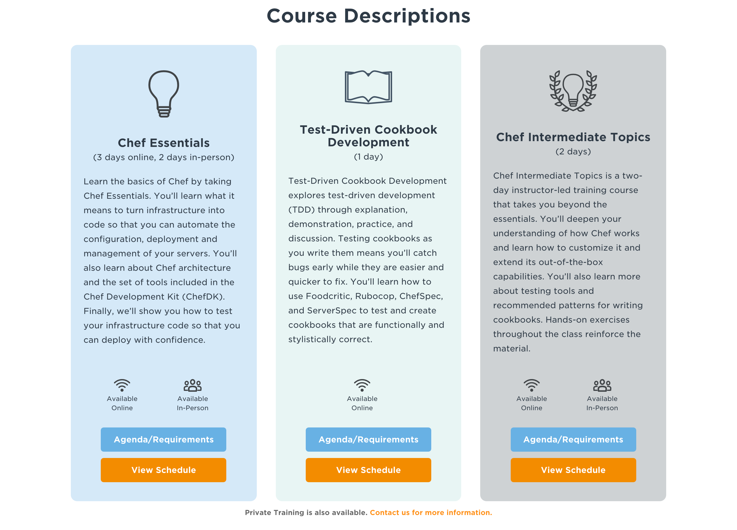
Test-Driven Cookbook Development
April 12 @ 8:00 am - 4:00 pm (PDT)
Sign up at https://www.chef.io/training
Use the code TDDWEB to take 15% off the cost of the course.

Slide 99
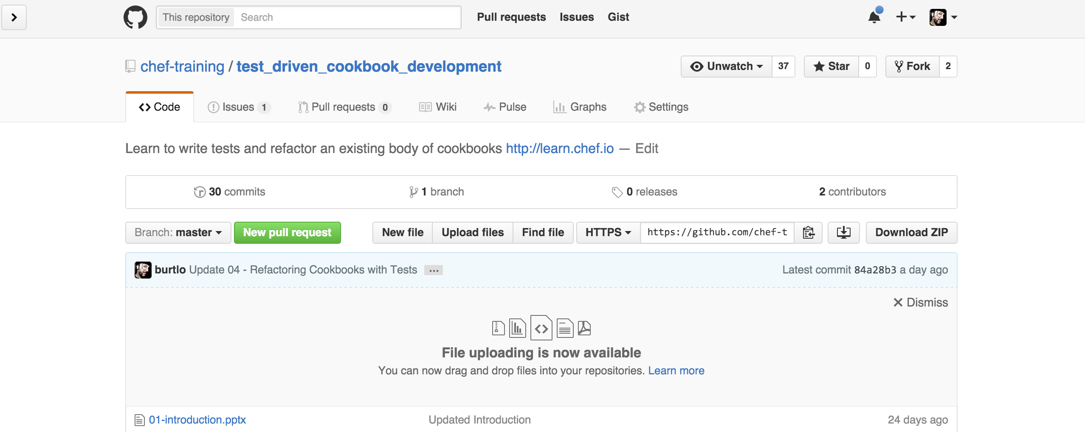
Test-Driven Cookbook Development
All the slides and the training content can be found on GitHub:
https://github.com/chef-training/test_driven_cookbook_development

Slide 100
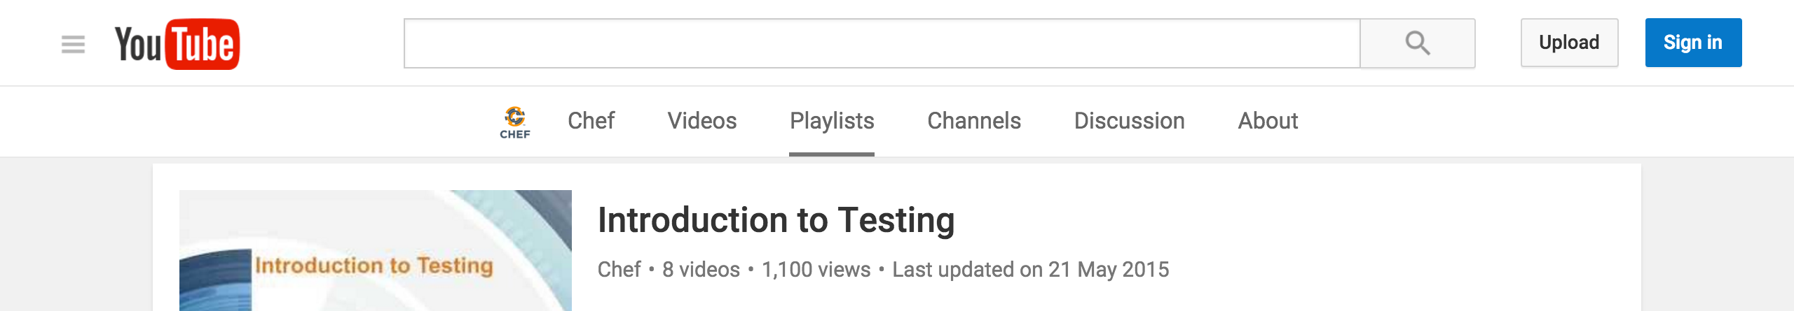
Webinars and Training Videos
Watch more Webinars.
Static Analysis - https://www.chef.io/webinars/?commid=175731
Test Kitchen - https://www.chef.io/webinars/?commid=167803
Visit and Subscribe to the Chef YouTube channel.
https://www.youtube.com/user/getchef/playlists

Slide 101
Testing Language Documentation
RSpec Documentation (https://relishapp.com/rspec)
ChefSpec Documentation (https://github.com/sethvargo/chefspec)
InSpec Documentation (https://docs.chef.io/inspec_reference.html)
ServerSpec Documentation (http://serverspec.org/resource_types.html)

Slide 102
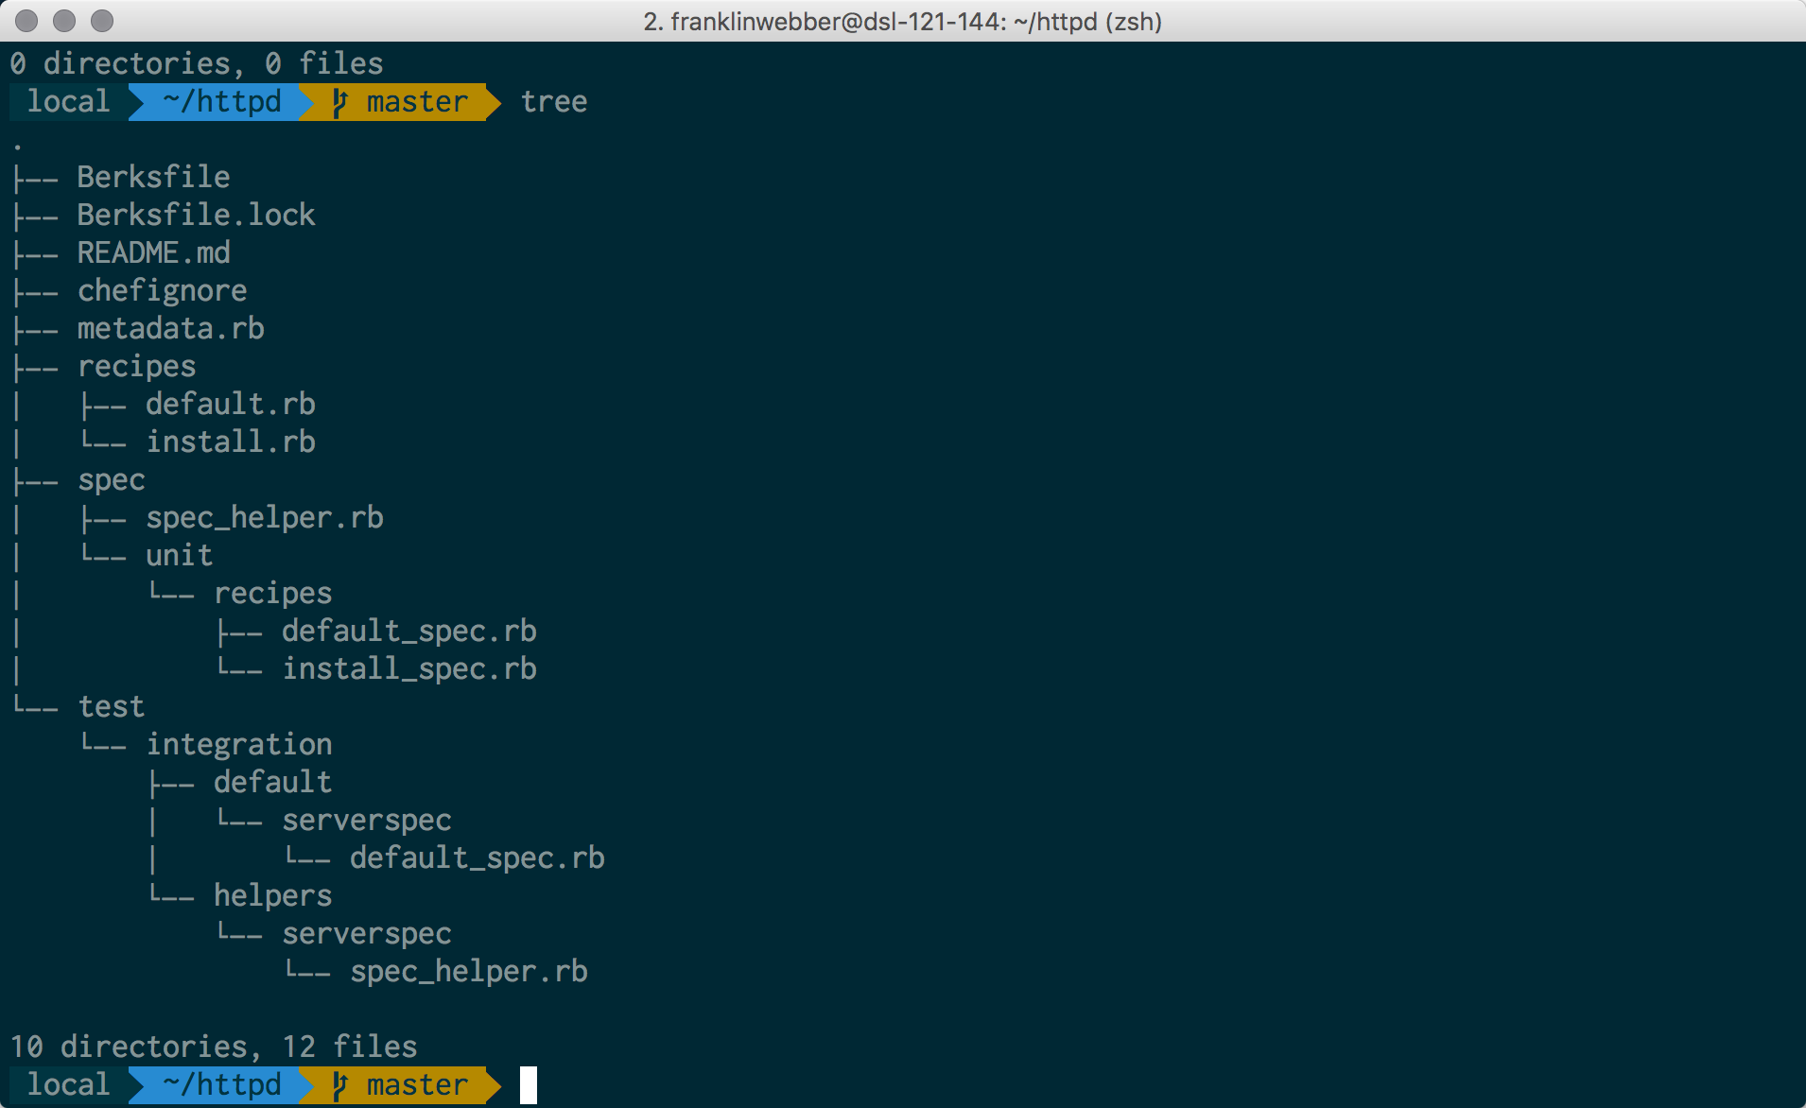
My Terminal
Mac OSX
iTerm2
Oh My Zsh
Agnoster Theme
Powerline Patched Font

Slide 103
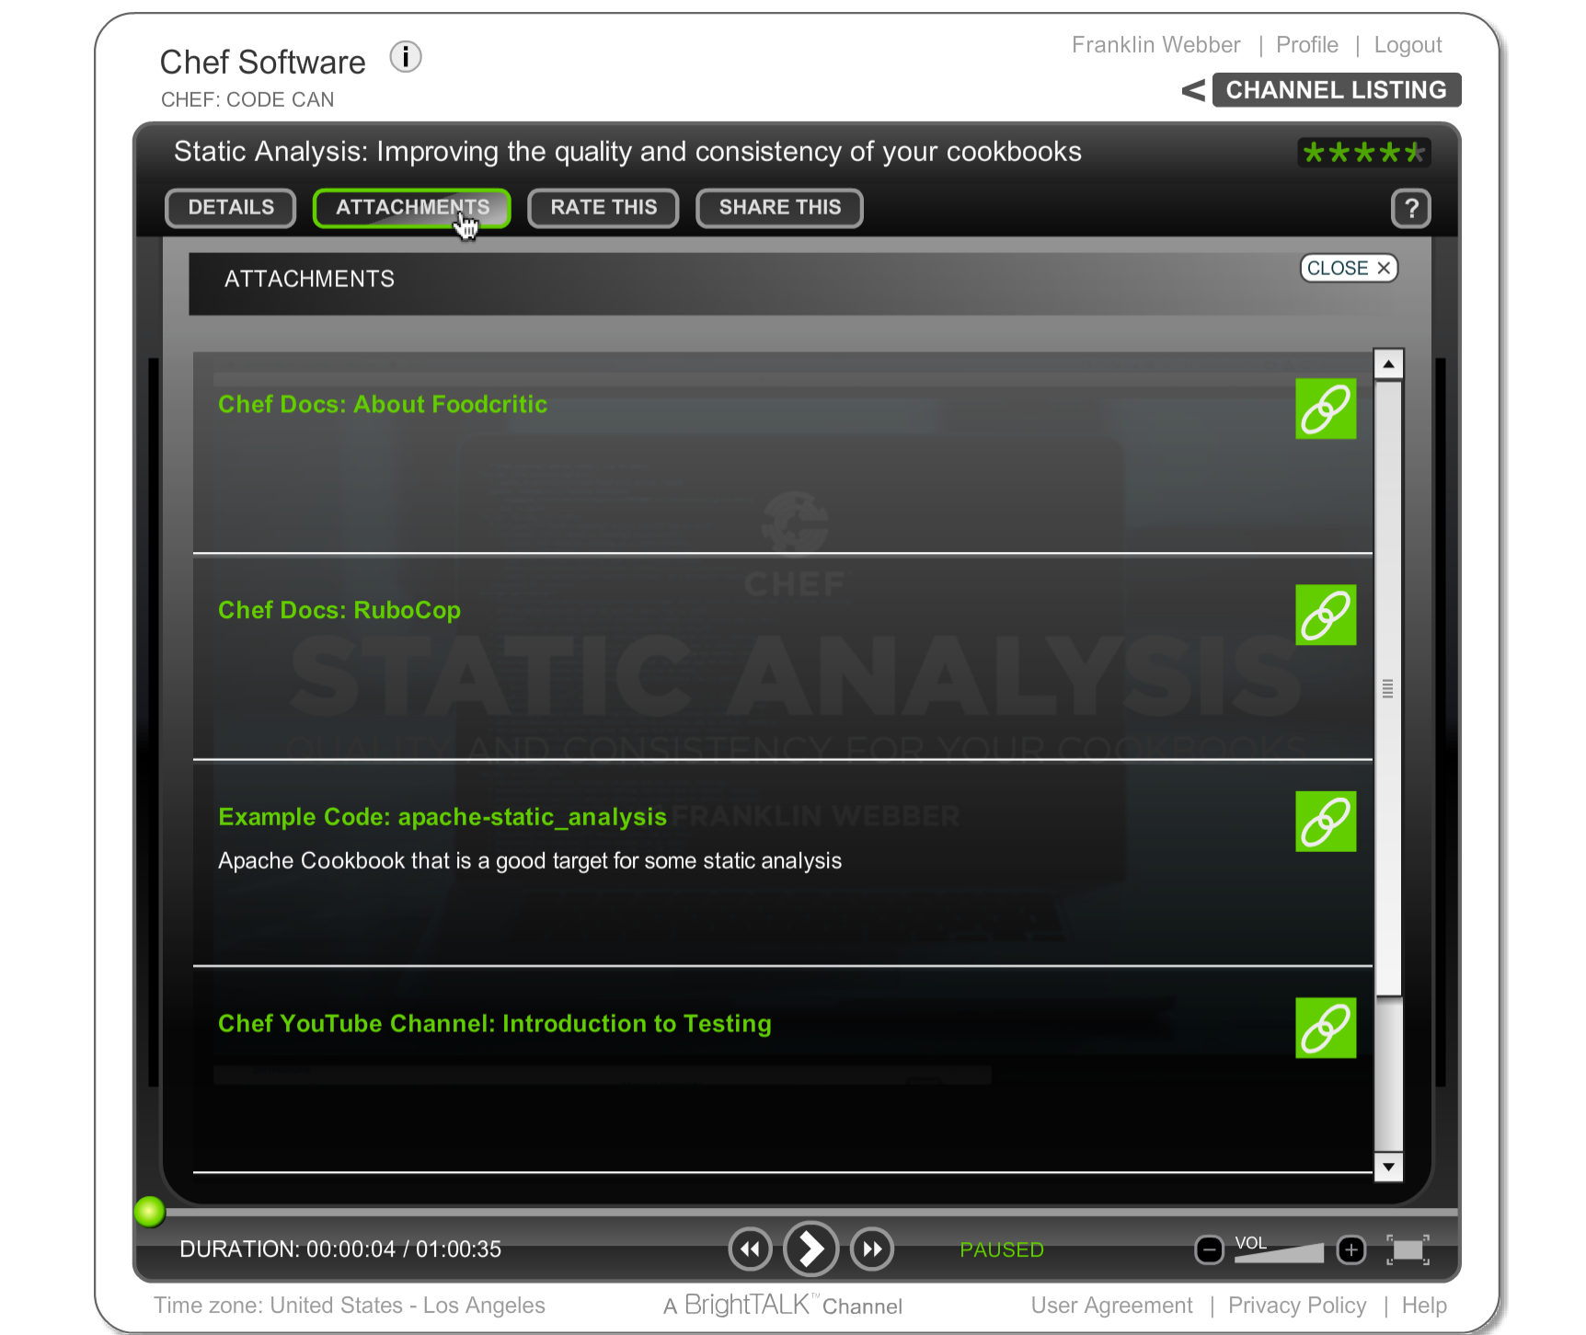
BrightTALK Attachments
All of the resources I am going to provide you can be found under "Attachments".

Slide 104
Agenda
Review Existing Cookbook
Faster Feedback with Unit Tests
Testing Resources
Refactoring to Attributes
Debugging
Further Resources

Slide 105
